Slide 1
Operating systems
Virtual Memory

Slide 2
Content Lecture#12
01
M
02
A
03
S
04
P
05
A

Slide 3

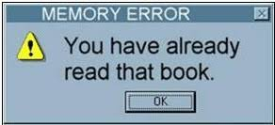
Lets take a Break
A programmer had a problem, so he used threds. Then he had two problems.

Slide 4
Virtual Memory
A
Address binding
is

Slide 5
Virtual Memory
Why we need virtual memory
The program size may exceed the amount of physical memory
The OS keeps those parts of the program currently in use in main memory and the rest on disk
The piece of the program being swapped between disk and memory as needed
Virtual memory can also work in a multiprogramming system
A technique that allows execution of a process without having to allocate it the memory space it needs, completely
It gives idea that large memory is available at programmer’s disposal even computer has relatively small main memory
A program can be written assuming large address space is available
That is the virtual address space >> physical address space
The entire logical address space of a process must be in physical memory before the process can execute
First Implemented in Intel 80386

Slide 6
Virtual Memory
Advantages of virtual memory:
Programs can be larger than the size of the physical memory
Virtual memory accommodates them
Virtual memory provides a logical view of memory which is larger than its physical size
Virtual memory is not easy to implement
May substantially decrease performance if it is used carelessly
Virtual memory can be implemented via:
Demand paging
Demand segmentation

Slide 7
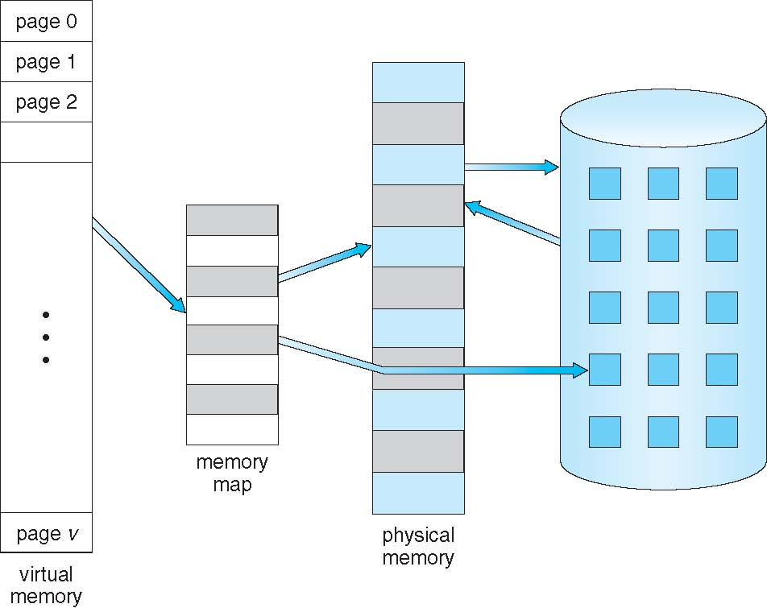
Virtual Memory
Demand Paging
In demand paging, bring a page into main memory only when it is needed
Less I/O needed
Less memory needed
Faster response
More users
Page is needed ➔ reference to it
Invalid reference → abort
Not in memory → bring to memory
It can also be implemented in a segmentation system
Demand Segmentation
Demand segmentation can also be used to provide virtual memory
Several systems provide paged segmentation scheme
Segments are broken into pages
The IBM OS/2 uses demand segmentation

Slide 8
Mechanism of Virtual Memory
When a new process is initiated, the system loader must load one page (start point) into real memory
Execution of the process will commence
This will continue as long as memory references generated by this page also within the same page
If the virtual address generated will reference a page which is not in real memory; this is termed as page fault, which generates an interrupt
The demand paging will be used and system loader will load the next demanded page
Execution will proceed after requested page is loaded
By a series of page faults occurring in this way, a sub-set (resident set) of the pages of a process will gradually accumulate in real memory
When the process terminates the OS releases all pages belonging to that process, making room for other processes

Slide 9
Mechanism of Virtual Memory
Additional techniques
Hardware techniques to improve performance of virtual paged system
Translation look aside buffer (TLB)
Associative mapping

Slide 10
Effective Memory access time
Effective Access Time (EAT)
EAT = (1 – p) x memory access
+ p (page fault overhead
+ swap page out
+ swap page in )
Memory access time = 200 nanoseconds
Average page-fault service time = 8 milliseconds
EAT = (1 – p) x 200 + p (8 milliseconds)
= (1 – p x 200 + p x 8,000,000)
If one access out of 1,000 causes a page fault, then
EAT = 8.2 microseconds.
This is a slowdown by a factor of 40!!
If want performance degradation < 10 percent
220 > 200 + 7,999,800 x p
20 > 7,999,800 x p
p < .0000025
< one page fault in every 400,000 memory accesses
T(eff) = hit ratio * (TLB access time + Main memory access time) + (1 – hit ratio) * (TLB access time + 2 * main memory time) = 0.6*(10+80) + (1-0.6)*(10+2*80) = 0.6 * (90) + 0.4 * (170) = 122

Slide 11
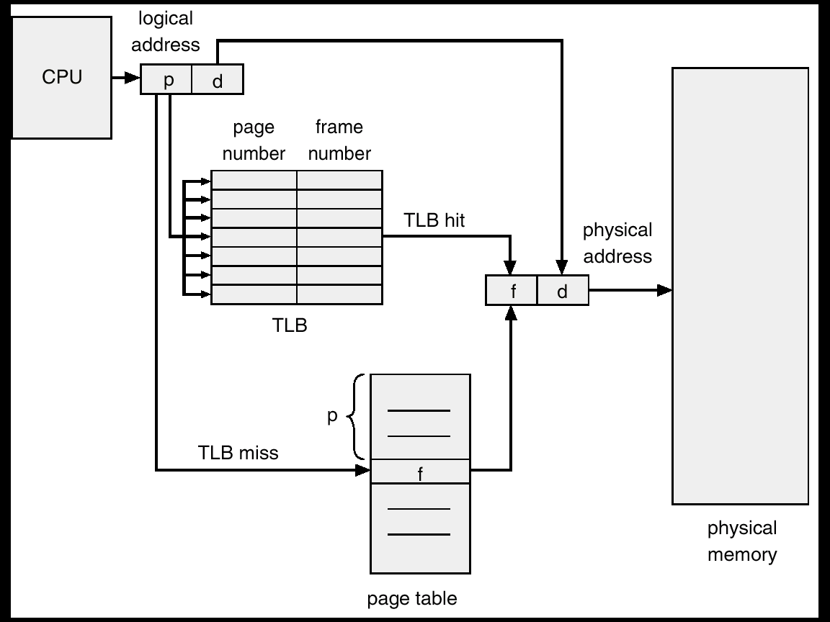
Translation Look aside Buffer
A bit is used in each page table entry to indicate whether the corresponding entry is in main memory or not
Each virtual memory reference can cause two physical memory accesses; one to fetch appropriate page table entry and one to fetch the desired data
To reduce this overhead on system performance a memory cache TLB is used in most of the systems
It is very fast and holds number of recently used page table entries
The virtual address translation process will first search in TLB. If found, the real address can be formed immediately. If not, normal accessing of page table will proceed
TLB holds limited number of page table entries, generally up to 32-4096
Page table entry size is usually 4-8 bytes

Slide 12
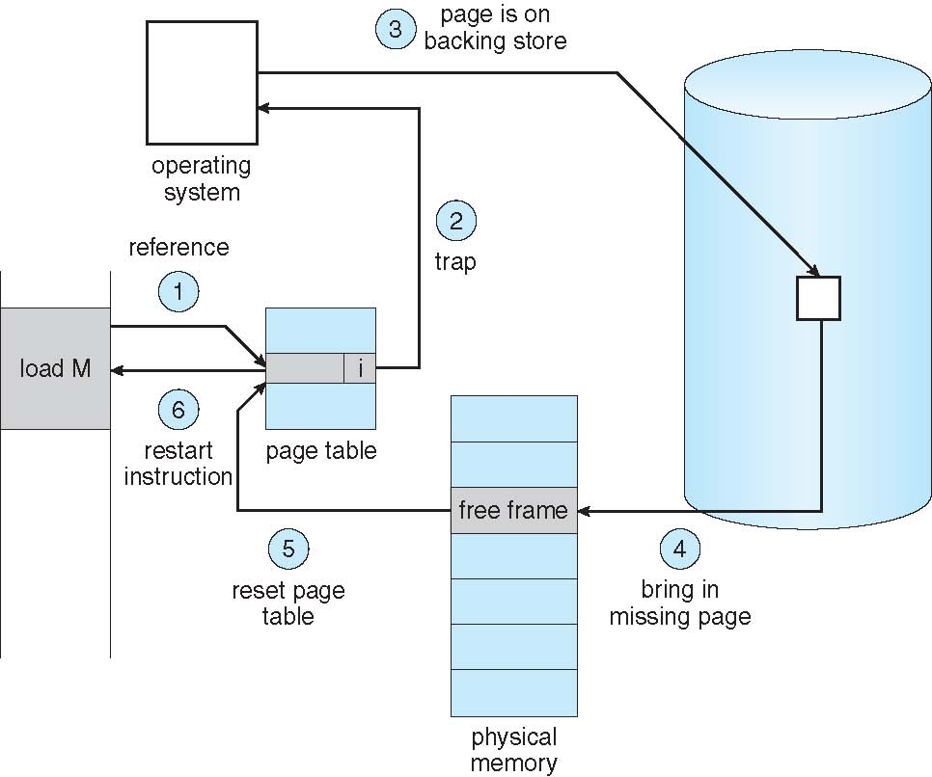
Page Fault
If the virtual address created a reference for a page which is not in real memory; it is termed as page fault
Following measures should be done when a page fault occur
Get empty frame
Swap page into frame
Reset tables, present or valid bit = 1
Restart instruction

Slide 13
Page Replacement
When a page fault occurs
The OS has to remove a page from memory to make room for incoming page
If the page to be removed has been modified it must be updated to disk
For better performance, at each page fault
Pick a random page from memory that is not heavily used and replace it
If a heavily used page is removed, it may have to brought back in quickly, resulting in extra overhead
Use modify (dirty) bit to reduce overhead of page transfers – only modified pages are written to disk
Page replacement procedure
If no frame is free, we free a frame by writing its contents to disk
Change page table entry that the page is no longer in memory
Swap in new demanded page
Update the page table entry

Slide 14
Page Replacement
There are different page replacement algorithms
Each OS has its own page replacement technique
The important thing is, it should be one with lowest page fault rate
Replacement policy/strategy is concerned with selecting a page currently in memory to be replaced
All policies are based on, the page that is removed should be the page least likely to be referenced in the near future
Principal of locality says, there is a high correlation between recent referencing history and near future referencing patterns
Most policies try to predict future behavior on the basis of past behavior

Slide 15
Page Replacement Algorithms
There are different page replacement algorithms
Each OS has its own page replacement technique
The important thing is, it should be one with lowest page fault rate
Replacement policy/strategy is concerned with selecting a page currently in memory to be replaced
All policies are based on, the page that is removed should be the page least likely to be referenced in the near future
Principal of locality says, there is a high correlation between recent referencing history and near future referencing patterns
Most policies try to predict future behavior on the basis of past behavior

Slide 16
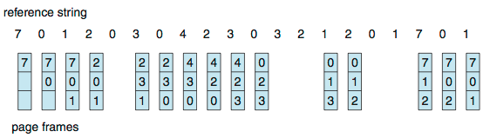
FIFO Algorithm
The FIFO maintain a list of all pages in memory with the page at the head the oldest one and page at the tail most recent arrival
On a page fault, the page at the head is removed and the new page added to tail of the list
Salient points
FIFO algorithm is very easy to implement
Its performance is not always good because it may replace pages heavily used throughout the life of a program
Low overhead paging algorithm
Reference string: 7,0,1,2,0,3,0,4,2,3,0,3,0,3,2,1,2,0,1,7,0,1
3 frames (3 pages can be in memory at a time per process)
Can vary by reference string: consider 1,2,3,4,1,2,5,1,2,3,4,5
Adding more frames can cause more page faults!
How to track ages of pages?
Just use a FIFO queue

Slide 17
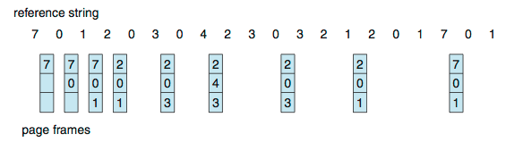
Optimal Algorithm
Replace the page that will not be used for the longest period of time is called principal of locality
This algorithm guarantees the lowest possible page fault rate
Salient points
Optimal replacement is much better than FIFO
Difficult to implement, since it requires future knowledge of reference string
Not used in practical systems because it cannot implement
Optimal algorithm is mainly used for comparison studies
Replace page that will not be used for longest period of time
9 is optimal for the example
How do you know this?
Can’t read the future
Used for measuring how well your algorithm performs

Slide 18
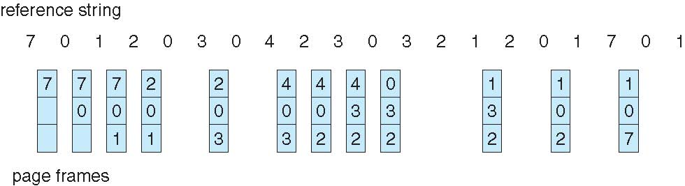
Least Recently Used (LRU) Algorithm
Least recently used (LRU) algorithm chooses that page that has not been used for the longest period of time
Salient points
LRU is quite good
Not easy to implement, the problem is to determine an order for the frames defined by the time of last use
Requires substantial hardware assistance because of tremendous overheads due to interrupts
LRU feasible as a stack
Keep a stack of page numbers
Whenever a page is referenced, it is removed from the stack and put on top
In this way the top of the stack contains MRU page and bottom LRU page
Use past knowledge rather than future
Replace page that has not been used in the most amount of time
Associate time of last use with each page
12 faults – better than FIFO but worse than OPT
Generally good algorithm and frequently used
But how to implement?

Slide 19
Not Used Recently Algorithm
Pages not used recently are not likely to be used in the near future and they may be replaced with incoming pages
NUR strategy is implemented with the addition of two hardware bits per page
Reference bit
RB = 0 if the page has not been referenced
RB = 1 if the page has been referenced
Modified bit
MB = 0 if the page has not been modified
MB = 1 if the page has been modified
Initially reference and modified bits are set to ‘0’
As a reference to a particular page occurs, the reference bit of that page is set to ‘1’
Whenever a page is modified its modified bit is set to ‘1’
Whenever a page is to be replaced
It finds a page that has not been referenced
Otherwise it selects a referenced but unmodified page
Otherwise, it will replace a modified page that must be written
back to the secondary storage
There will be less overheads involved if algorithm finds a page in the lowest numbered group
Group 1 Unreferenced Unmodified
Group 2 Unreferenced Modified
Group 3 Referenced Unmodified
Group 4 Referenced Modified
Which group seems impossible?

Slide 20
Random Page Replacement Algorithm
Choose random page and replace it
This strategy could select any page for replacement, including the next page to be referenced
Random page replacement decisions can be made quickly
This scheme is rarely used

Slide 21
Least Frequently Used (LFU) Algorithm
LFU page replacement algorithm replaces the page from memory which is least frequently used
It keeps a counter for the number of references to each page and the page with the smallest count is replaced
This algorithm suffers from the situation in which a page initially used heavily, but then never again used

Slide 22
Most Frequently Used (MFU) Algorithm
MFU page replacement algorithm replaces the page from memory which is most frequently used
It is based on the argument that the page with the smallest count was probably just brought in and has yet to be used
Its implementation is expensive
Neither MFU nor LFU replacement algorithm is common

Slide 23
Allocation of Frames
Each process needs minimum number of frames
Example: IBM 370 – 6 pages to handle SS MOVE instruction:
instruction is 6 bytes, might span 2 pages
2 pages to handle from
2 pages to handle to
Maximum of course is total frames in the system
Two major allocation schemes
fixed allocation
priority allocation
Many variations

Slide 24
Fixed Allocation
Equal allocation – For example, if there are 100 frames (after allocating frames for the OS) and 5 processes, give each process 20 frames
Keep some as free frame buffer pool
Proportional allocation – Allocate according to the size of process
Dynamic as degree of multiprogramming, process sizes change

Slide 25
Priority Allocation
Use a proportional allocation scheme using priorities rather than size
If process P_{i} generates a page fault,
select for replacement one of its frames
select for replacement a frame from a process with lower priority number

Slide 26
Global vs. Local Allocation
Global replacement
Process selects a replacement frame from the set of all frame
one process can take a frame from another
Local replacement
Each process selects from only its own set of allocated frames

Slide 27
Non-Uniform Memory Access
So far all memory accessed equally
Many systems are NUMA – speed of access to memory varies
Consider system boards containing CPUs and memory, interconnected over a system bus
Optimal performance comes from allocating memory “close to” the CPU on which the thread is scheduled
And modifying the scheduler to schedule the thread on the same system board when possible
Solved by Solaris by creating lgroups
Structure to track CPU / Memory low latency groups
Used my schedule and pager
When possible schedule all threads of a process and allocate all memory for that process within the lgroup

Slide 28
Thrashing
If a process does not have “enough” pages, the page-fault rate is very high
Page fault to get page
Replace existing frame
But quickly need replaced frame back
This leads to:
Low CPU utilization
Operating system thinking that it needs to increase the degree of multiprogramming
Another process added to the system
Thrashing ≡ a process is busy swapping pages in and out

Slide 29
Thank you

